Slide 1
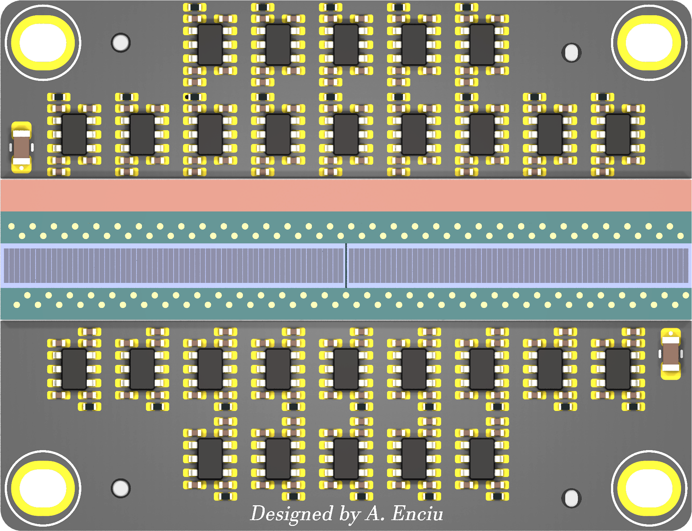
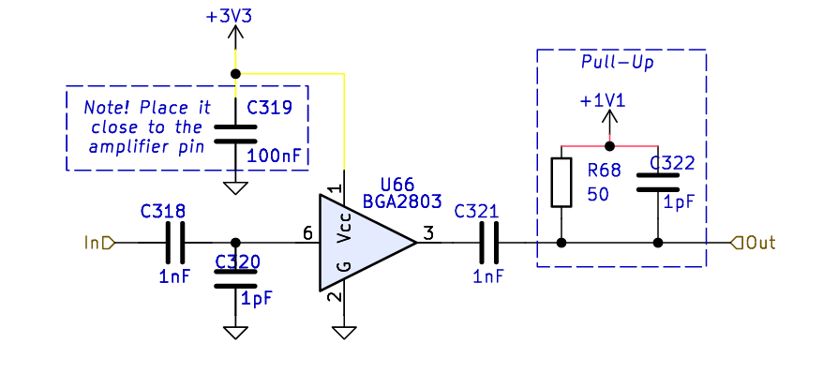
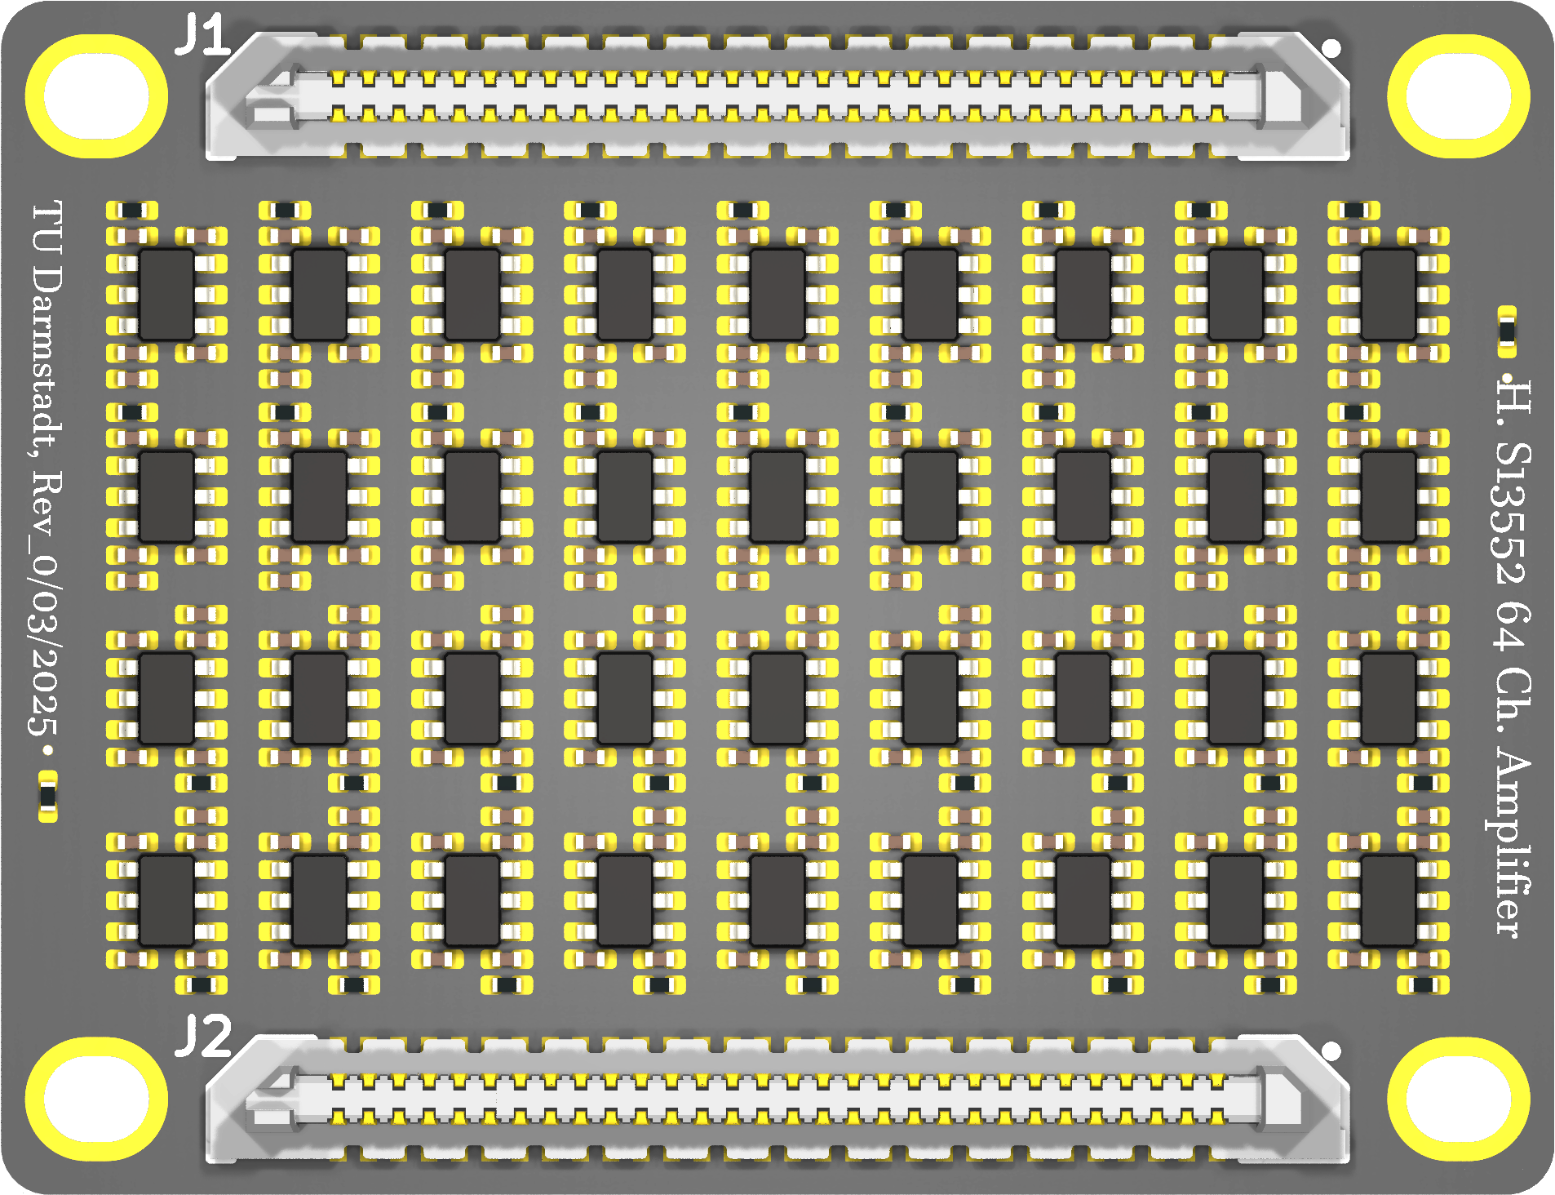
New Amplifier Based on BGA2803
TOP VIEW
Hamamatsu S13552
https://www.hamamatsu.com/eu/en/product/optical-sensors/mppc/mppc_mppc-array/S13552.html
SMA connector
BOTTOM VIEW
page_4: https://jspc29.x-matter.uni-frankfurt.de/trb/schematics/PADIWA3-all.pdf
W. Zhi et al 2024 JINST 19 P06011 DOI 10.1088/1748-0221/19/06/P06011
Joshua W Cates et al 2018 Phys. Med. Biol. 63 185022 DOI 10.1088/1361-6560/aadbcd
F. Simon NIM-A Volume 926, 11 May 2019, Pages 85-100 Doi.org/10.1016/j.nima.2018.11.042

Slide 2
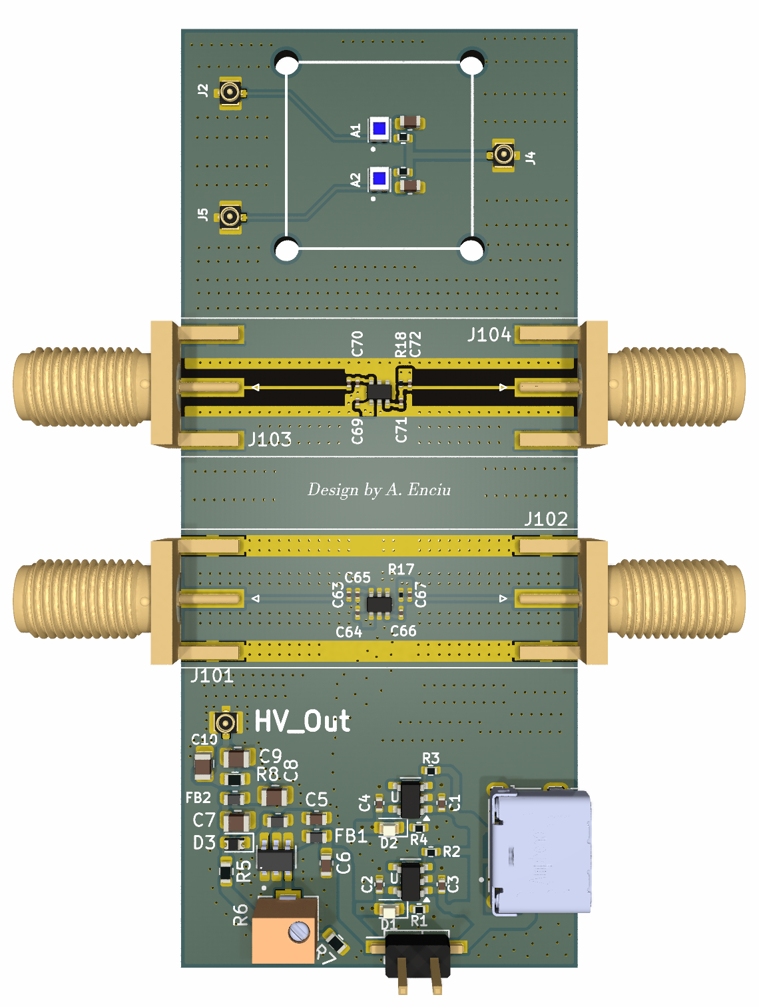
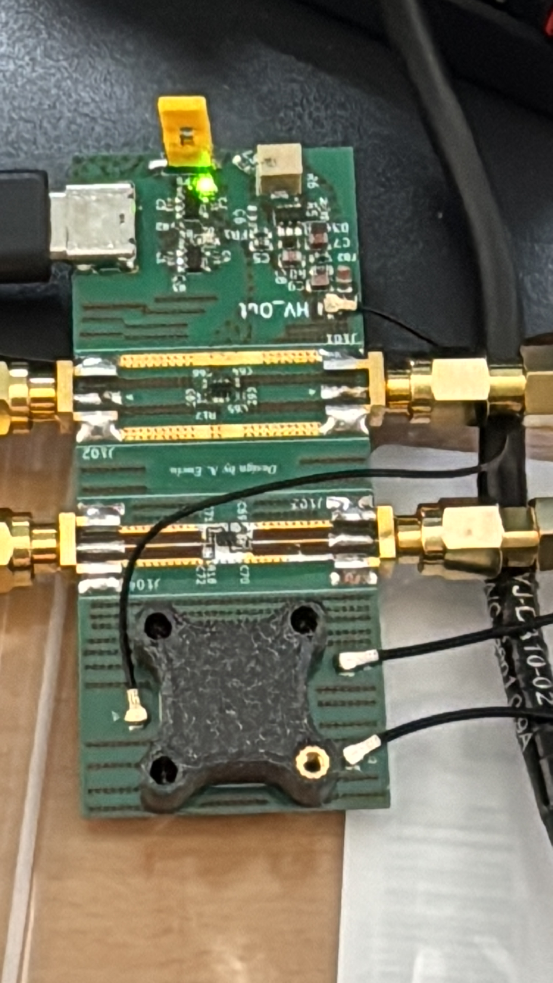
BGA2803 Demo Board
2 RF amplifiers
2 SiPMs
1 HV PSU
Power via USB-C

Slide 3
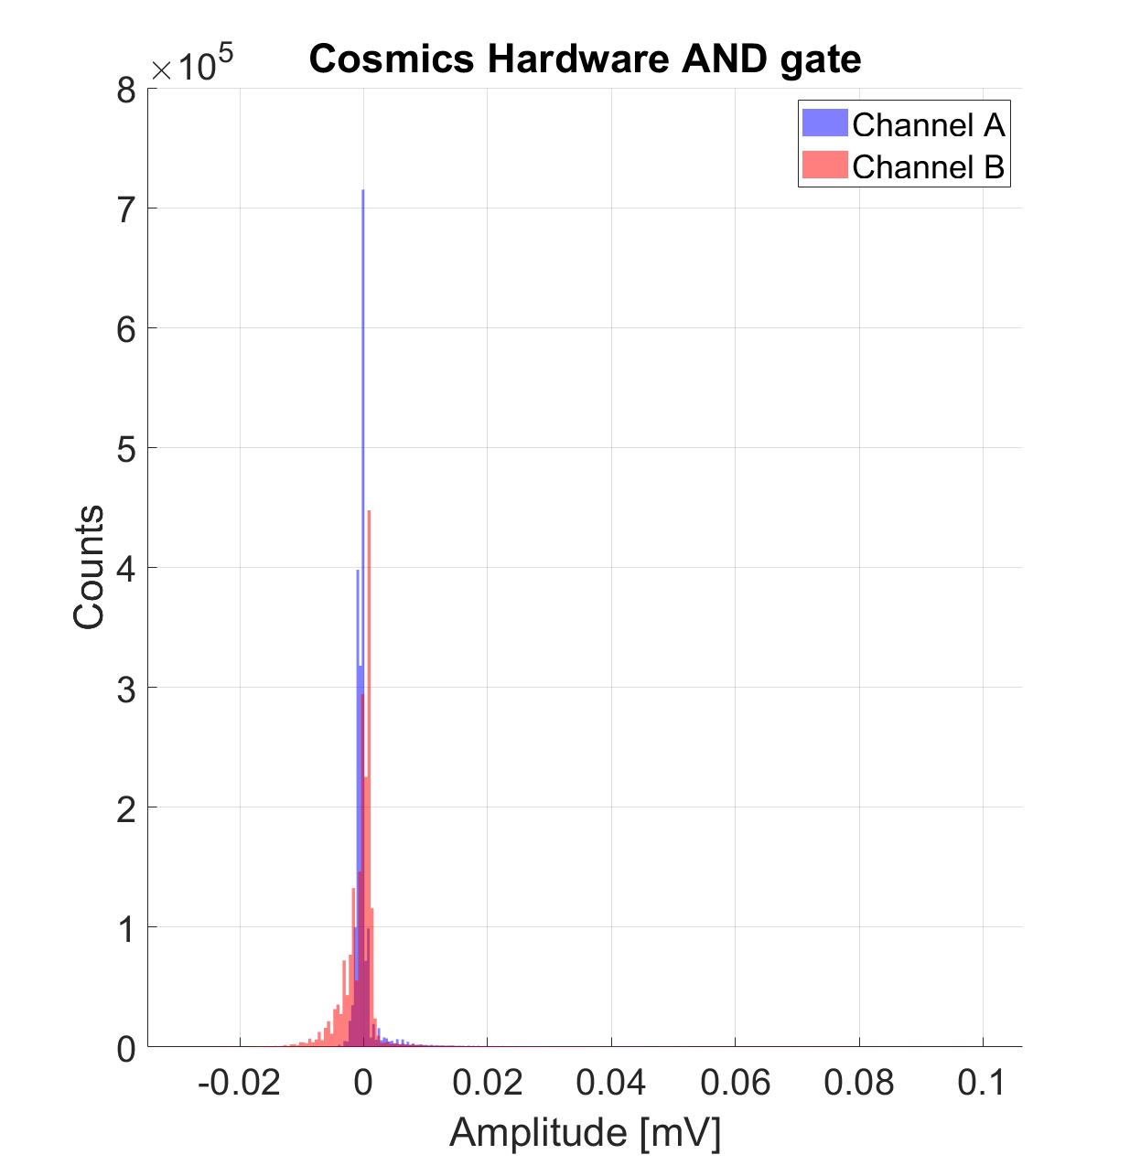
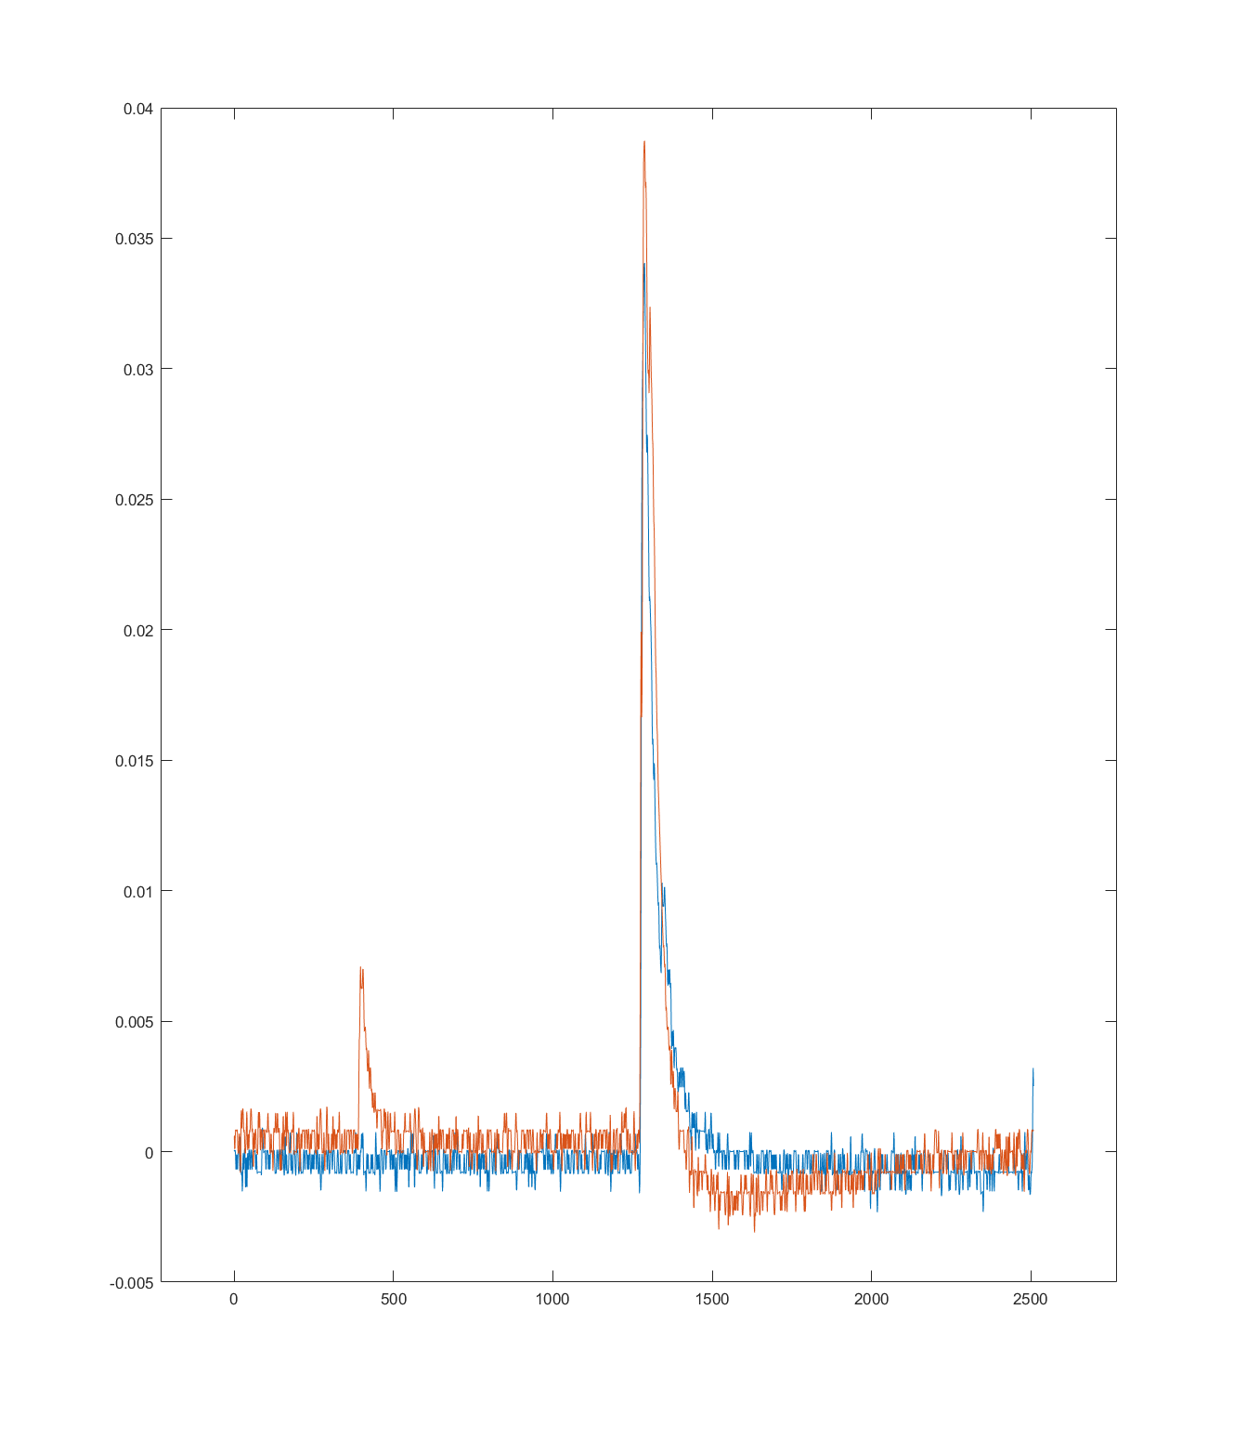
Cosmics on the oscilloscope
Amplitude (V)
Time (ns)

Slide 4
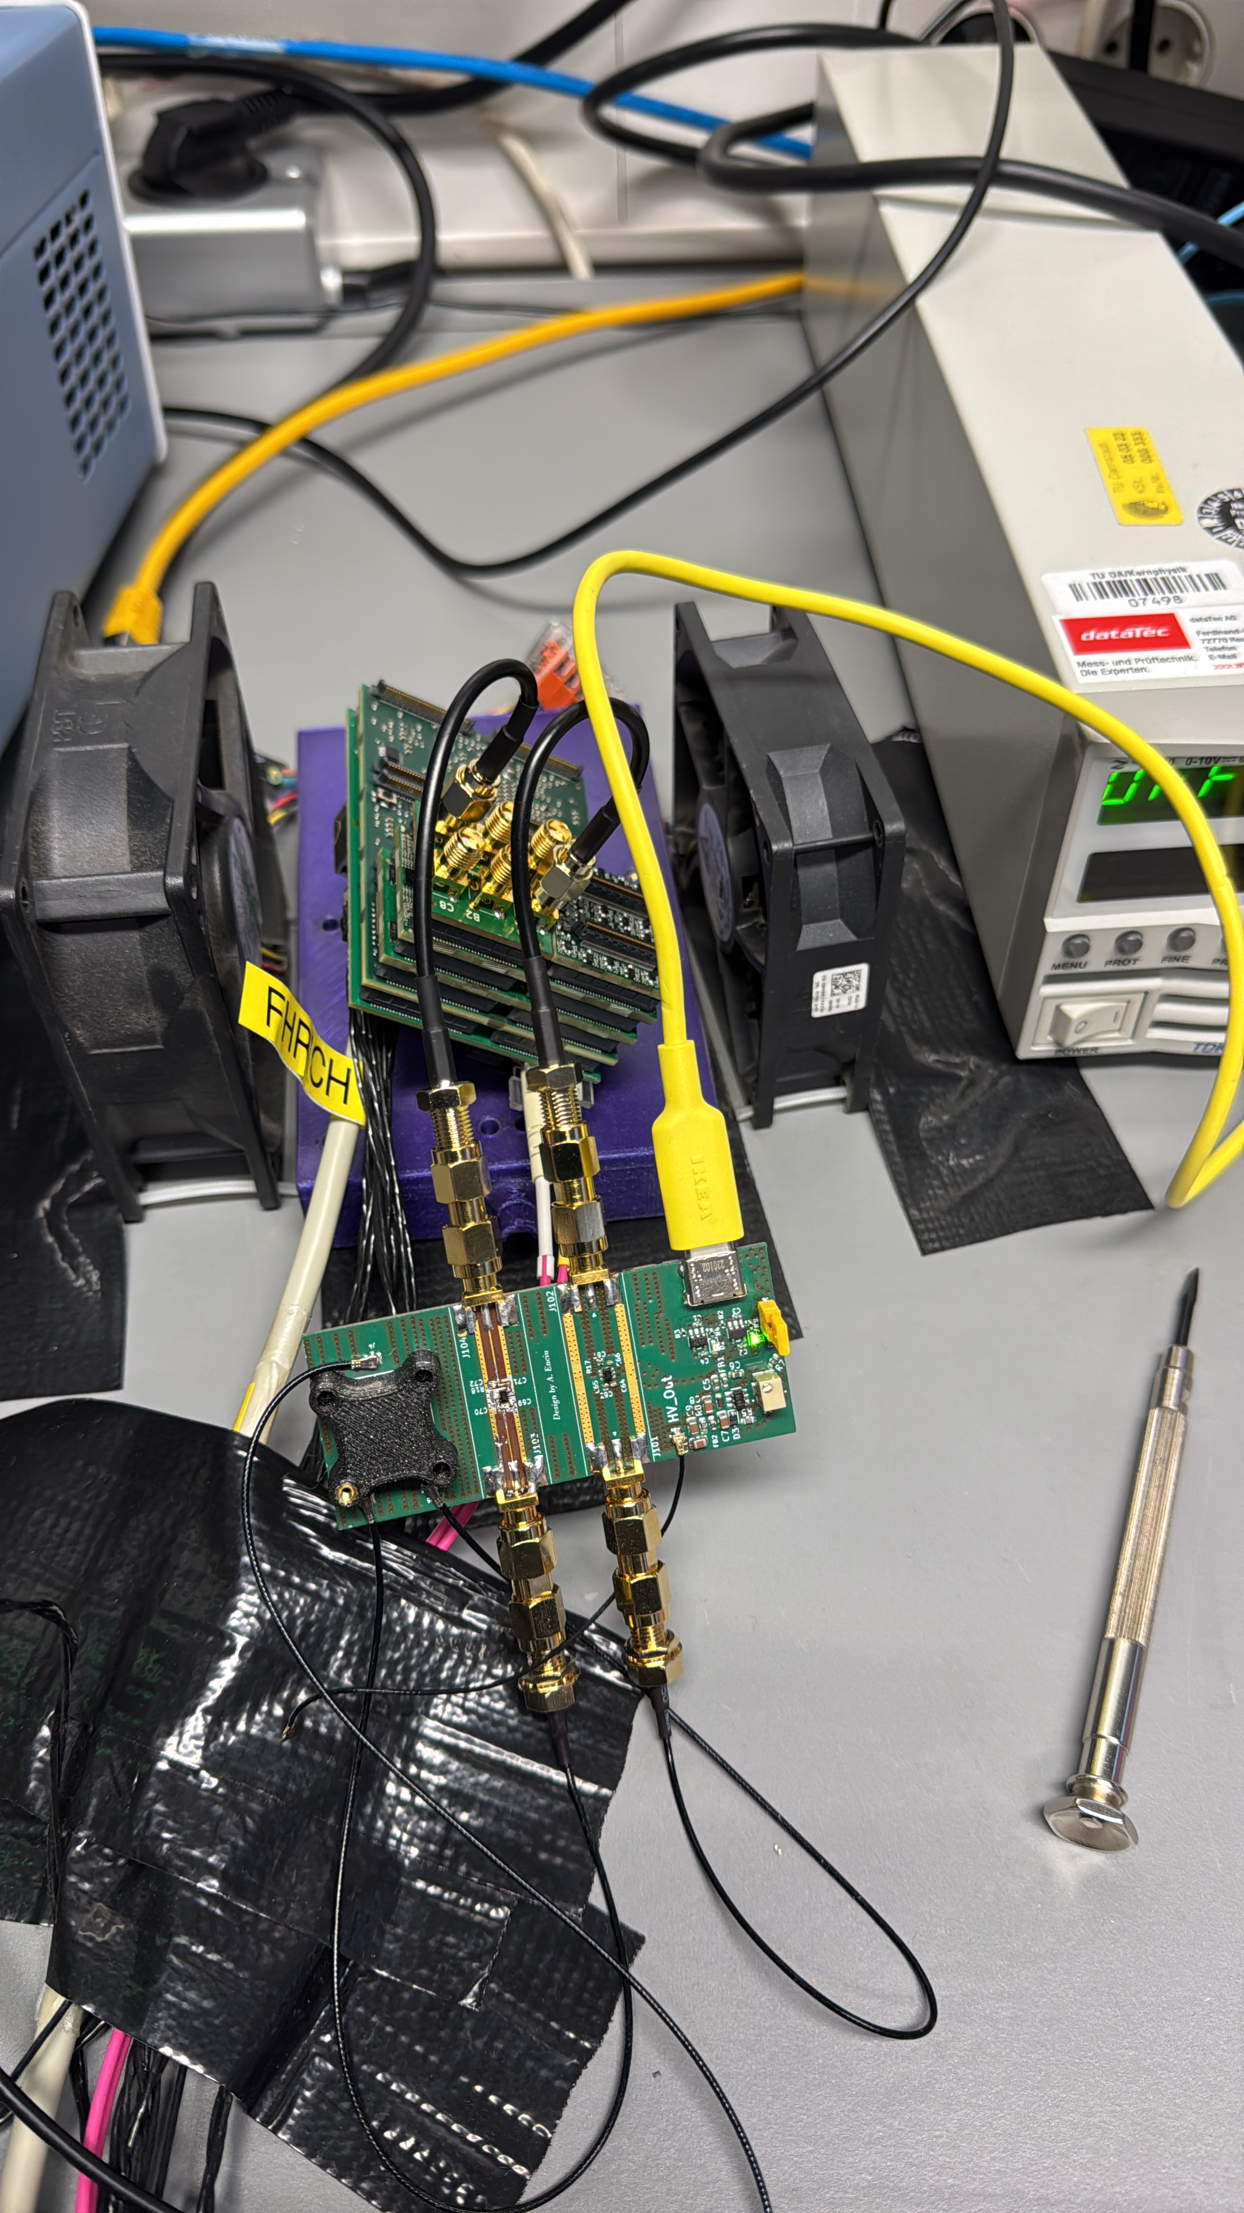
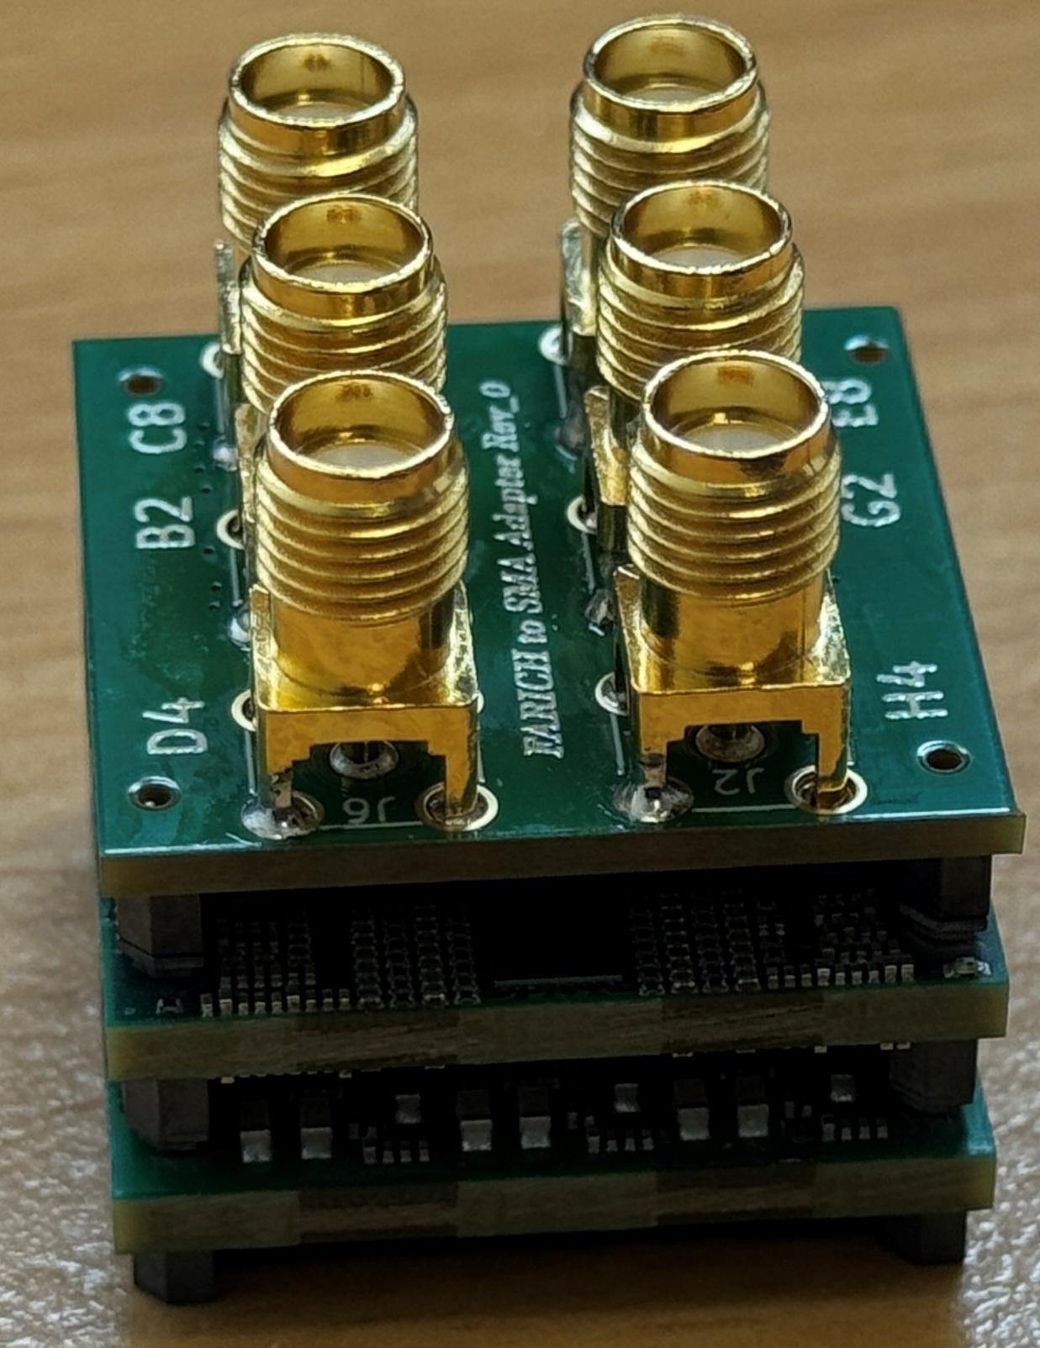
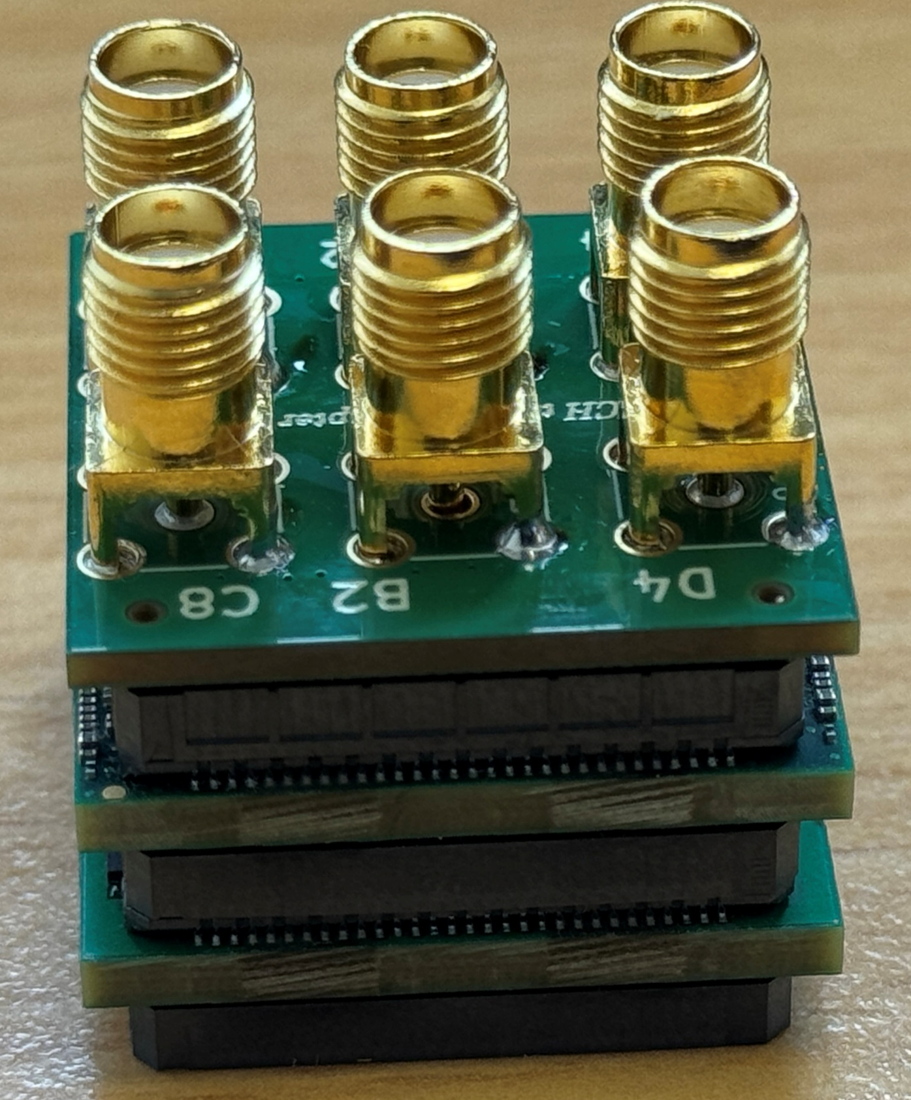
FARICH-SMA adapter
- Replaces the original amplifier
- Signals are inserted directly in the FPGA
Demo board
SMA cable
FARICH

Slide 5
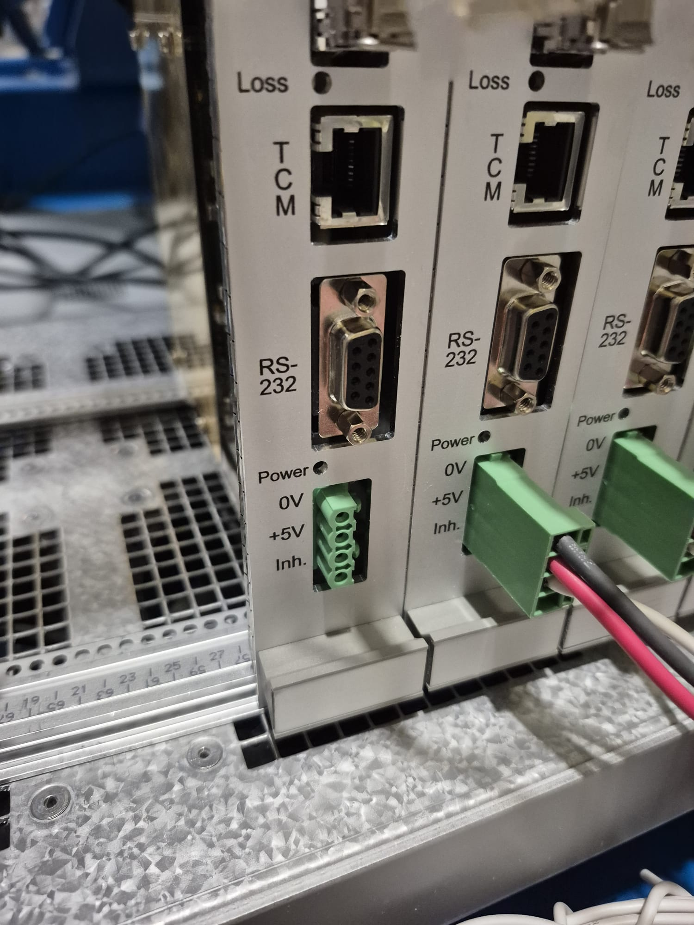
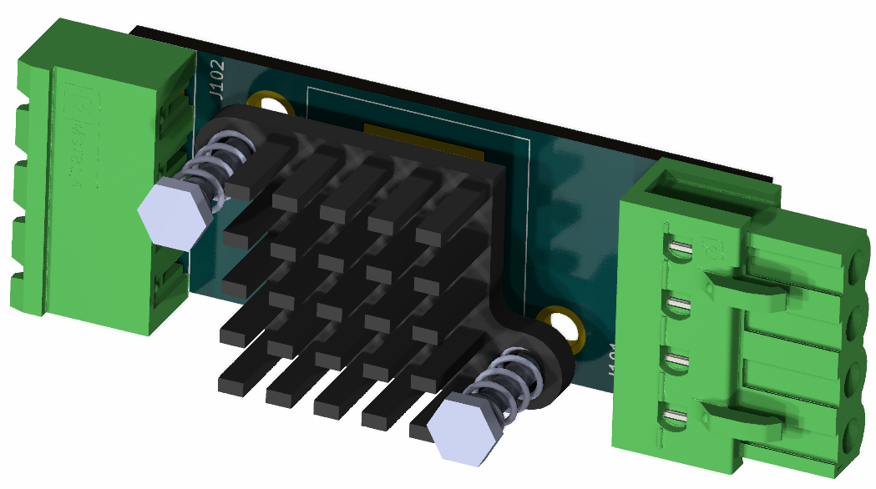
PUMA FEC PSU
5.5V to 5V low noise LDO
Additional Pi filter (CLC) from 5 kHz
Power Switch
Heatsink
Works with the existent infrastructure

Slide 6
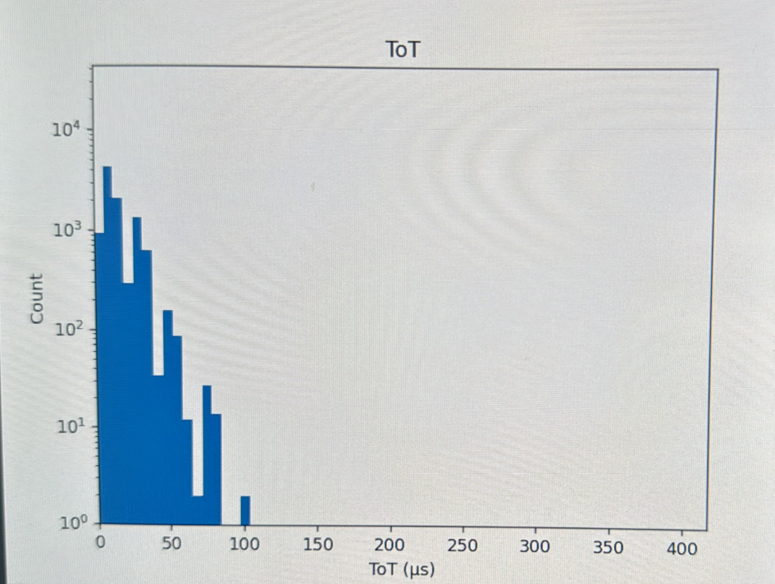
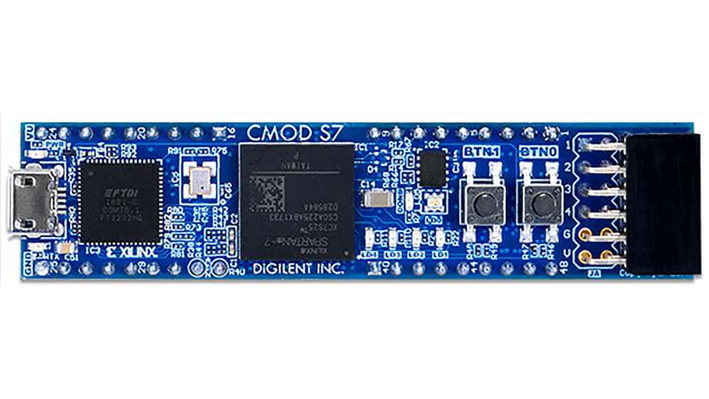
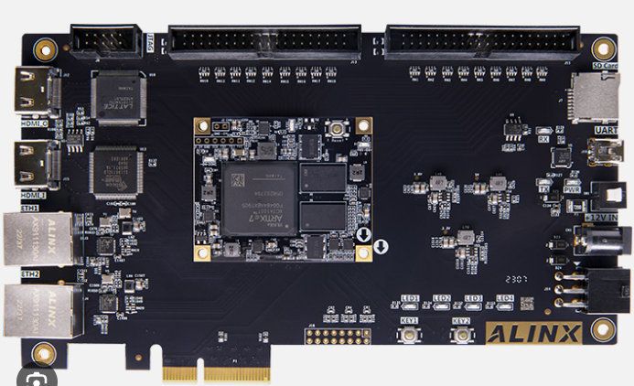
64-Ch FPGA-Based MCA
Prototype (1-Ch) CMOD-S7/A7
12 MHz Clock (83.33 ns/cycle)
16-bit counter (83.33 ns – 5.4 ms)
Data transmitted via USB 2.0
Prototype (64-Ch) Alinx 7103
100 MHz clock (10 ns/cycle)
Data transmitted via UDP
Custom made FPGA Board
Alinx board specs in a smaller format
Live readout

